Slide 1
Project Summary – 25th March – 24th June: Project Motivation, Work Done, and Further Work to Do

Slide 2
Project Motivation
Generally speaking, trying to find insights of .mat files through different measurements (joint angles, positions, accelerometer values, etc.) and extracted statistical features of NSAA and 6 min walk files by sequence modelling using RNNs and CRFs
Ideally build models that can learn the features of human movement
(Current) aim is to build a reasonably good model that, when presented with new, unseen .mat files, can give a reasonably good approximation of individual NSAA scores and overall cumulative NSAA score
Should be able to do this with the same model if the newly presented file is of a 6 minute walk, NSAA assessment, or unstructured movement
Idea is this could aid specialists in the scoring and assessment of patients’ activity scores
Another aim is to use a trained model to gain insights into most influential activities and measurements from .mat file on overall NSAA score and to identify activities that correlate highly with overall assessment
Possibly could enable the reduction of 17 activities to far fewer if only a few are needed to correctly assess the subject
Only class of models currently being used is the RNN; however, shall be experimenting with CRFs built in Python shortly and compare them with RNN counterparts
Also would like to look at implementing RNNs with CRFs and seeing how this affects classification and regression performance

Slide 3
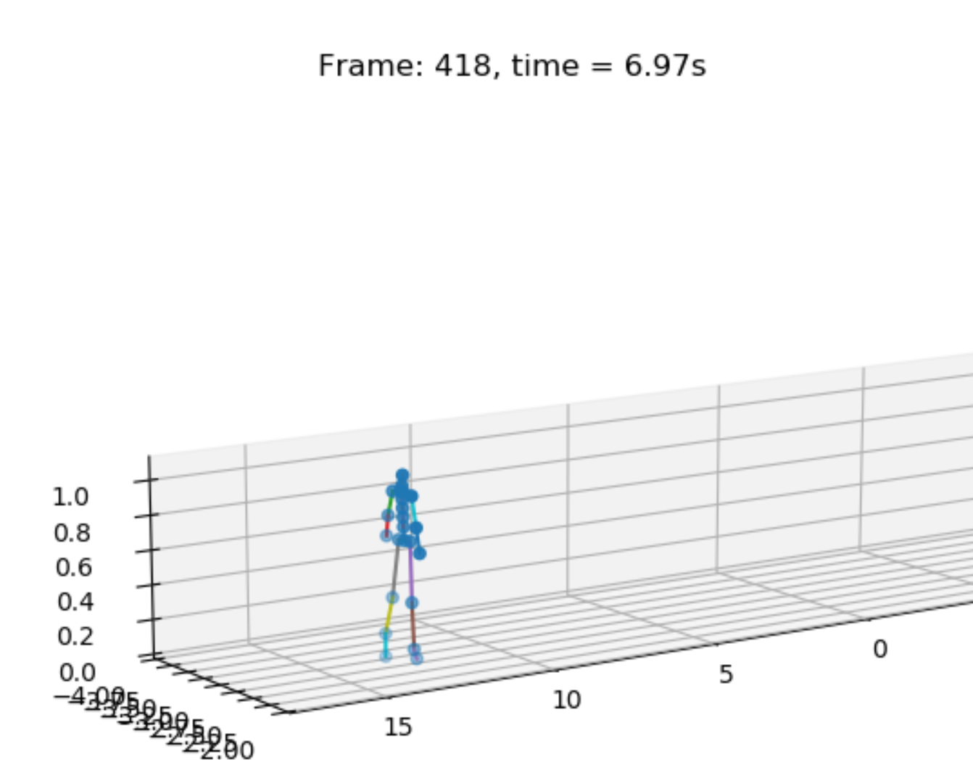

Scripts and Data Ecosystem
Google sheet activity annotations
Suit data (one .mat file per subject visit)
Unseen suit data .mat file (e.g. from NSAA tests, 6MW, or unstructured movement)
‘mat_act_div.py’
‘comp_stat_vals.py’
3D visualization of suit data over time
‘model_predictor.py’
Suit data as .mat files (each file is 1 act of 1 subject)
Extracted statistical features
Prediction of overall NSAA score, single act scores, and classification labels given pre-trained models
‘ext_raw_measures.py’
‘ft_sel_red.py’
Raw measurement data from .mat files
Reduced-dim statistical features
‘rnn.py’
‘RNN Results.xlsx’
‘graph_creator.py’
Single act score of 0, 1, or 2 of a single sequence (only for single-act files)
Overall NSAA regression score (between 0 and 34) of a single sequence
Classification of being from either ‘D’ or ‘HC’ file of a single sequence
Classification of NSAA single activity scores for all 17 actions of a single sequence

Slide 4
Preliminary Experiment Results
Primarily testing for only one type of output (‘overall NSAA regression score’) to save time, as results on other metrics are consistent with this one
Results are based on testing single sequences from source .mat files that haven’t been used to train the model
However, this is in line with our ability to assess a complete file: taking a complete file, we can test models on each sequence in the file and aggregate predictions on individual sequences to get predictions for the whole file (as done in ‘model_predictor.py’)
Experiments done include:
Determining how well an RNN model regresses on different types of source data
Using the same file type categories as above, see how well these file types predict the individual activity NSAA scores (i.e. between 0 and 2)
Using all available raw measurements in ‘AD’ files, extract each of them into ‘.csv’s and use these in turn to train and predict on RNNs
As the ‘AD’ file type for ‘NSAA’ files isn’t particularly accurate investigate whether this is due to lack of data or innate predictive power
Looks at the ability of an RNN model to predict a single activity score (0, 1, or 2) given data that comes from single-act subject files w/ associated labels from a Google sheet
Having established 4 of the raw measurements that are useful for RNN models, use longer sequences (standard up to this point was ’60’ due to 60Hz so sequences of length 60 from raw measurement files captured 1s of data)
Looking at how the number of features extracted from statistical features from ‘NSAA\AD’ files affected the ability of the RNN model in question to learn
Having looked at different sequence lengths for raw measurement data, repeated the process with ‘NSAA\AD’ files

Slide 5
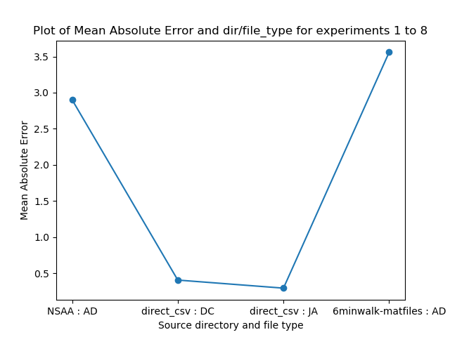
Experiment Set #1
Determining how well an RNN model regresses on different types of source data
Types are raw joint angle data from ‘JA’ and ‘DC’ (data cube) files, ‘AD’ (all data) files from NSAA assessments, and ‘AD’ files from 6-minute walks
Raw joint angle files from ‘JA’ and ‘DC’ perform much better (MAE = ~0.35) than ‘AD’ files (MAE = ~3.2)
Possibly reason for ‘JA’ and ‘DC’ performing so well could be that there aren’t that many subjects w/ these files, so not as diverse training set used
Suggests that raw data measurements might be better put through RNN than extracted statistical features

Slide 6
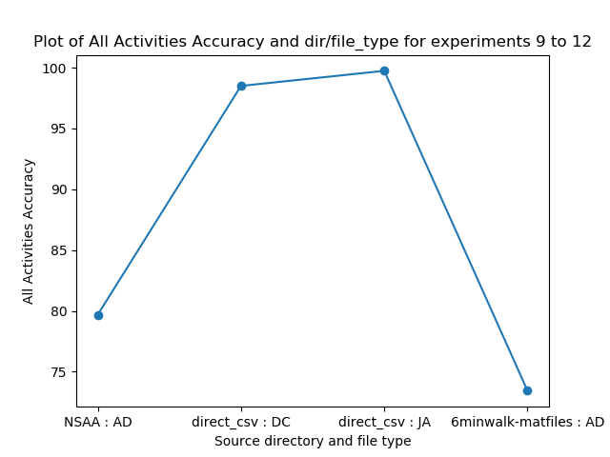
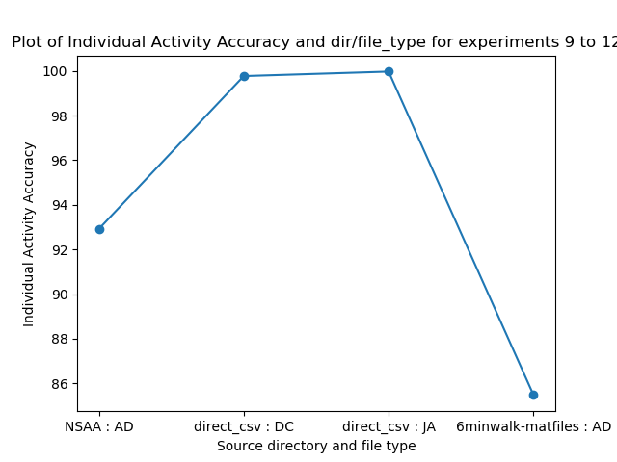
Experiment Set #2
Using the same categories as above, see how well these file types predict the individual activity NSAA scores (i.e. between 0 and 2)
Metrics used are ‘individual accuracy’ (i.e. for sets of 17 #s for each test sequence, what percentage of individual 0, 1, or 2s are predicted correctly) and ‘all accuracy’ (i.e. for sets of 17 #s, what percentage of complete sets are predicted perfectly?)
Again, raw joint angle files from ‘JA’ and ‘DC perform much better on both ‘indiv acc’ (~99% vs ~89% from ‘AD’) and ‘all act’ (~98% vs 76% from ‘AD’)

Slide 7
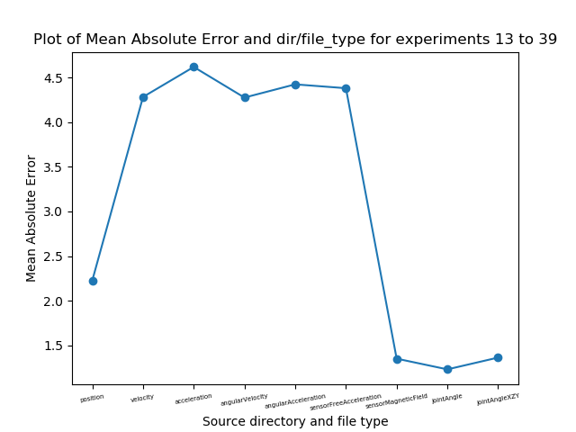
Experiment Set #3
Using all available raw measurements in ‘AD’ files, extract each of them into ‘.csv’s and use these in turn to train and predict on RNNs
Measurements used were ‘position’, ‘velocity’, ‘acceleration’, ‘angularVelocity’, ‘angularAcceleration’, ‘sensorFreeAcceleration’, ‘sensorMagneticField’, ‘jointAngle’, ‘jointAngleXZY’
Useful raw measurements include ‘position’ (MAE = ~2.4), ‘sensorMagneticField’, ‘jointAngle’ and ‘jointAngleXZY’ (all have MAE = ~1.3)

Slide 8
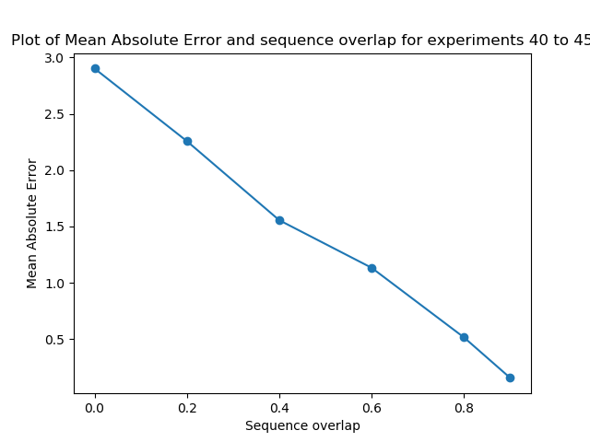
Experiment Set #4
As the ‘AD’ file type for ‘NSAA’ files isn’t particularly accurate (as seen in experiment set #1 at MAE = ~2.9), investigate whether this is due to lack of data or innate usefulness in predictive power
Act of extracting statistical features reduces the size of the source file many fold (i.e. if computing stat features over 60 rows of source data, amount of data going into RNN later on is reduced 60-fold)
By introducing ability to have sequence overlaps when creating data for input into RNN, we not only get a lot more data but also increases a chance to capture complete actions in sequences rather than just existing in ‘clipped’ form
Shows that in increasing the sequence overlap (which increases the data samples we have from 742 samples at 0.0 overlap to 7420 samples at 0.9 overlap), the NSAA overall score regression decreases dramatically

Slide 9
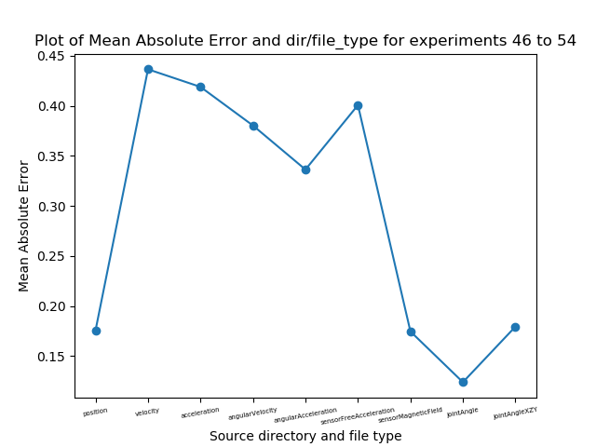
Experiment Set #5
Looks at the ability of an RNN model to predict a single activity score (0, 1, or 2) given data that comes from single-act subject files w/ associated labels from a Google sheet
Uses ‘mat_act_div.py’ to break up the file into time slots which contain the 17 activites, whereupon ‘ext_raw_measures.py’ extracts the raw measurements of each file (as done in experiment set #3), with y labels that correspond to each sequence’s source file and activity number
As expected, ‘position’, ‘sensorMagneticField’, ‘jointAngle’, and ‘jointAngleXZY’ all have low MAE when it comes to a single sequence’s ability to predict the activity score of the subject activity in question

Slide 10
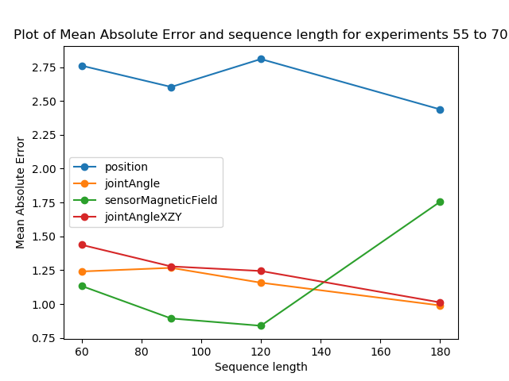
Experiment Set #6
Having established 4 of the raw measurements that are useful for RNN models, we next experimented with using longer sequences (standard up to this point was ’60’ due to 60Hz so sequences of length 60 from raw measurement files captured 1s of data)
However, if longer sequences are used, then there are fewer available sequences overall (i.e. if ‘capturing window’ got bigger with fixed amount of data available, then there are fewer ‘captures’ needed to go over all data)
To compensate for longer sequences reducing number of samples dramatically, we increased the sequence overlap to compensate; hence, the number of sequences stays more-or-less static while the sequence length gets longer
Surprisingly, longer sequences to capture longer time context isn’t necessarily more useful and if they are, it doesn’t improve accuracy by much (i.e. with ‘jointAngle’ and ‘jointAngleXZY’)

Slide 11
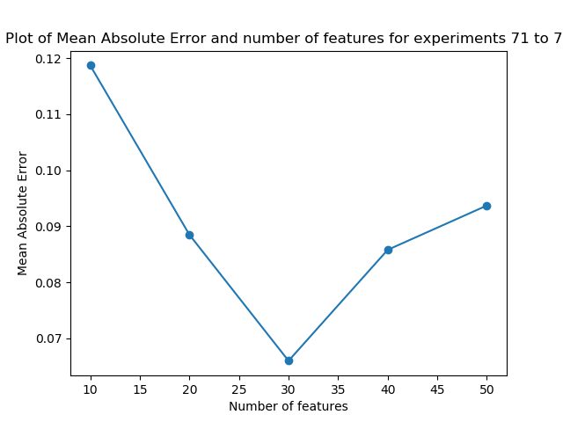
Experiment Set #7
Here looked at how the number of features extracted from statistical features from ‘NSAA\AD’ files affected the ability of the RNN model in question to learn
The ‘ft_sel_red.py’ script reduces statistical features dimensionality from files from ‘comp_stat_vals.py’ from ~10k to ~30
Up to this point, have been using PCA as the feature reduction technique of choice and reducing to 30 features, as this was shown to capture ~99% of the variance of the files
This is shown to be a good number of features, as fewer than that don’t capture enough of the variance (as shown in a marked increase in MAE), while more features, while capturing more of the variance, are more difficult to learn from (presumably due to the ‘curse of dimensionality’)

Slide 12
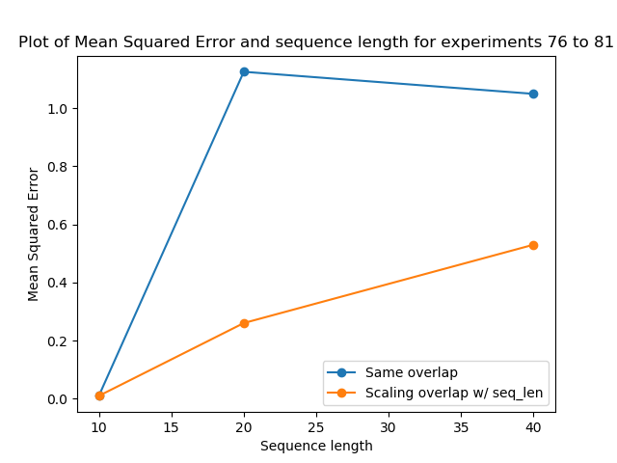
Experiment Set #8
Having looked at different sequence lengths for raw measurement data, we now repeat the process with ‘NSAA\AD’ files
Up until now, we’ve been using ’10’ as the sequence length for ‘NSAA\AD’ files, but as the statistical features that are extracted are computed over 60 rows of raw data (i.e. over 1s worth), a sequence length here corresponds to sequences of statistical features of 10s
Orange line corresponds to increasing the overlap in line with the sequence length to keep the same number of overlap samples (as done in experiment set #6), while the blue line shows results from not doing this (i.e. higher sequence length means lower number of sequences)
In both cases, longer sequence window than the default of 10 is worse (with keeping the same amount of samples doing something to compensate for this, shown by orange line)
Implies that context window of beyond 10s for a single NSAA regression is too long for the RNN to use usefully

Slide 13
Proposed Next Steps
Currently, models generalise well to unseen data from subject files that it has seen before
E.g. does well on all metrics on test data that has been ‘held out’ from the training set but whose sequences come from the same files as the data used to train
However, models struggle to generalise to new subjects
Limits the ability of the models to be used on new subjects’ data; hence, ability to generalise beyond the source files is necessary
As there are many different RNN models built from different raw measurements and extracted statistical features, it would be useful to build and ensemble of these to use on unseen files within ‘model_predictor.py’
Also will be writing a ‘CRF’ model in Python to act as an alternative to the ‘RNN.py’ script as seen in the script ecosystem
Idea is to use features selected via ‘ft_sel_red.py’ to select most useful statistical values from ‘comp_stat_vals.py’ and use these as inputs to a ‘CRF’

